Slide 1
1. Connect
2. Git
3. Docker
4. Kubernetes
5. CI/CD
6. Misc

Slide 2
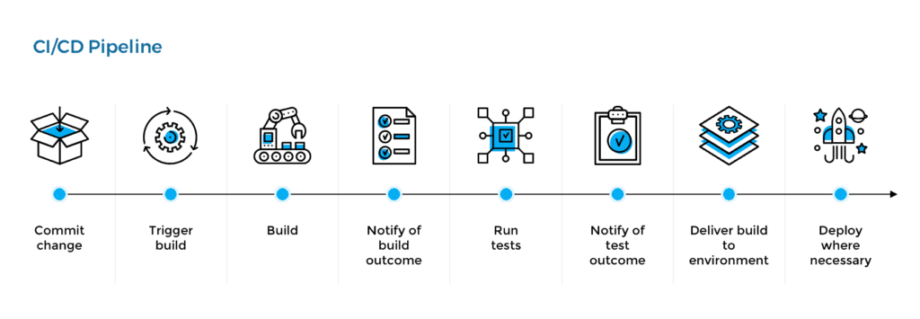
Pipeline concept

Slide 3
CD/CD Pipeline
Developer pushes to git repository
GitHub Webhook
Triggers Jenkins
Jenkins copies GitHub Repo
Dockerfile
App code
Test code
Jenkins has Docker build
an image based on the
Dockerfile
Jenkins Deploys the container
with the application code
and desired tests are executed

Slide 4
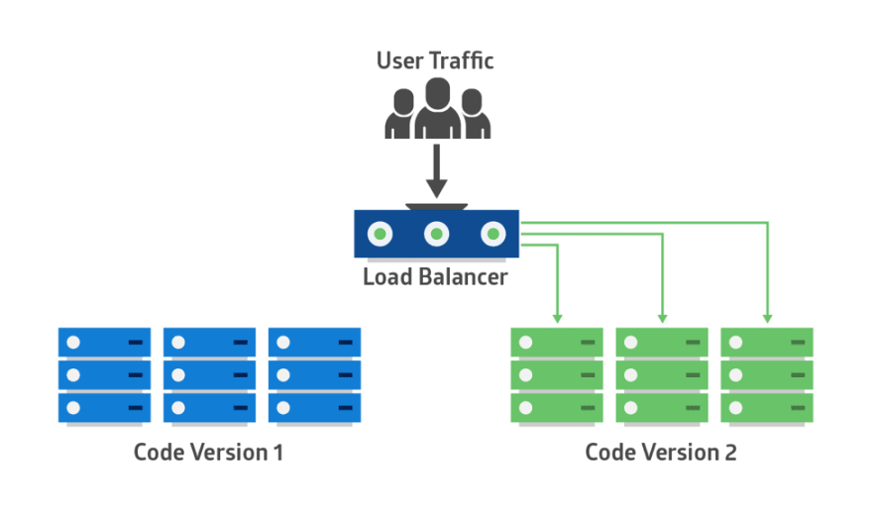
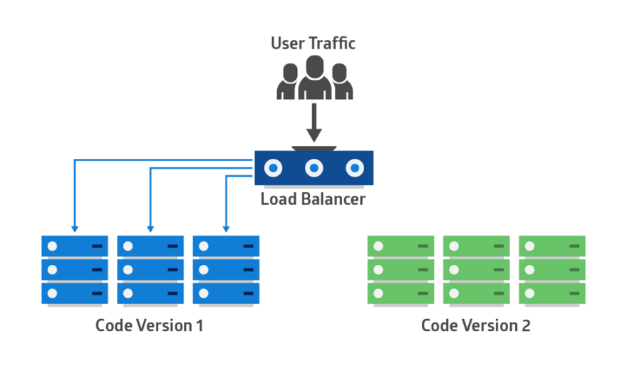
Blue / Green Deployment

Slide 5
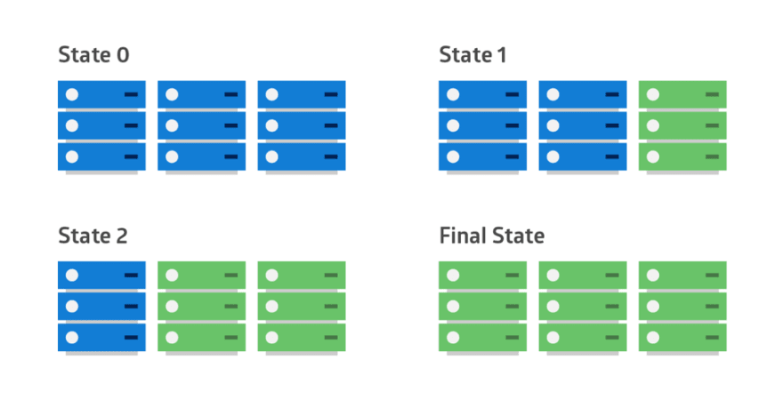
Rolling Deployment

Slide 6
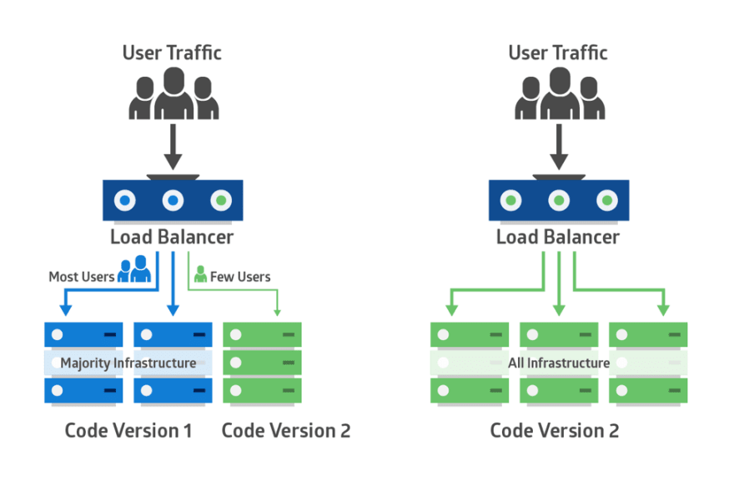
Canary Deployment

Slide 7
1. Connect
2. Git
3. Docker
4. Kubernetes
5. CI/CD
6. Misc

